Slide 1

AEG 2023 Annual Meeting
Marriott Portland Downtown Waterfront
Portland, Oregon - September 19-24, 2023

Slide 2
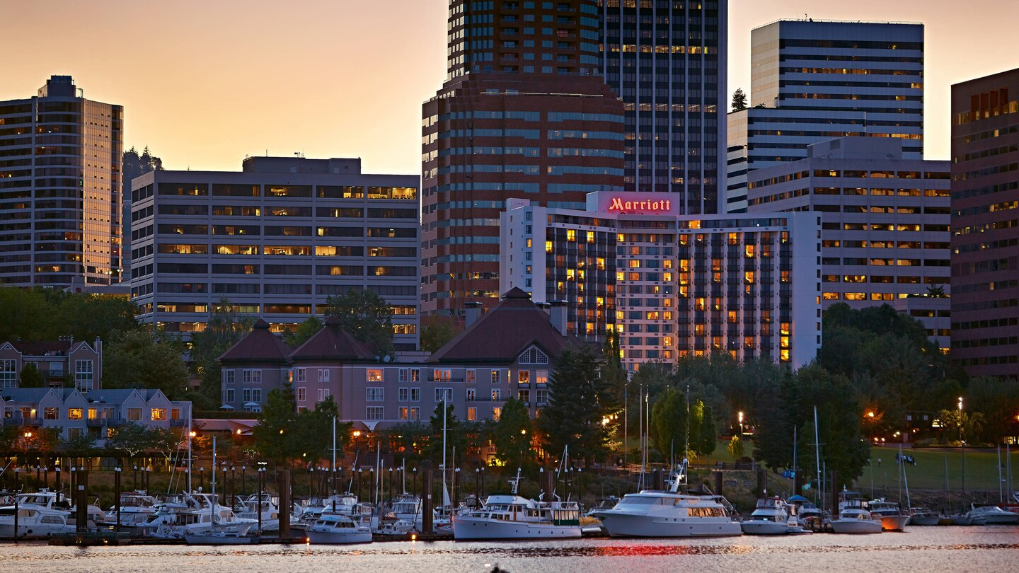

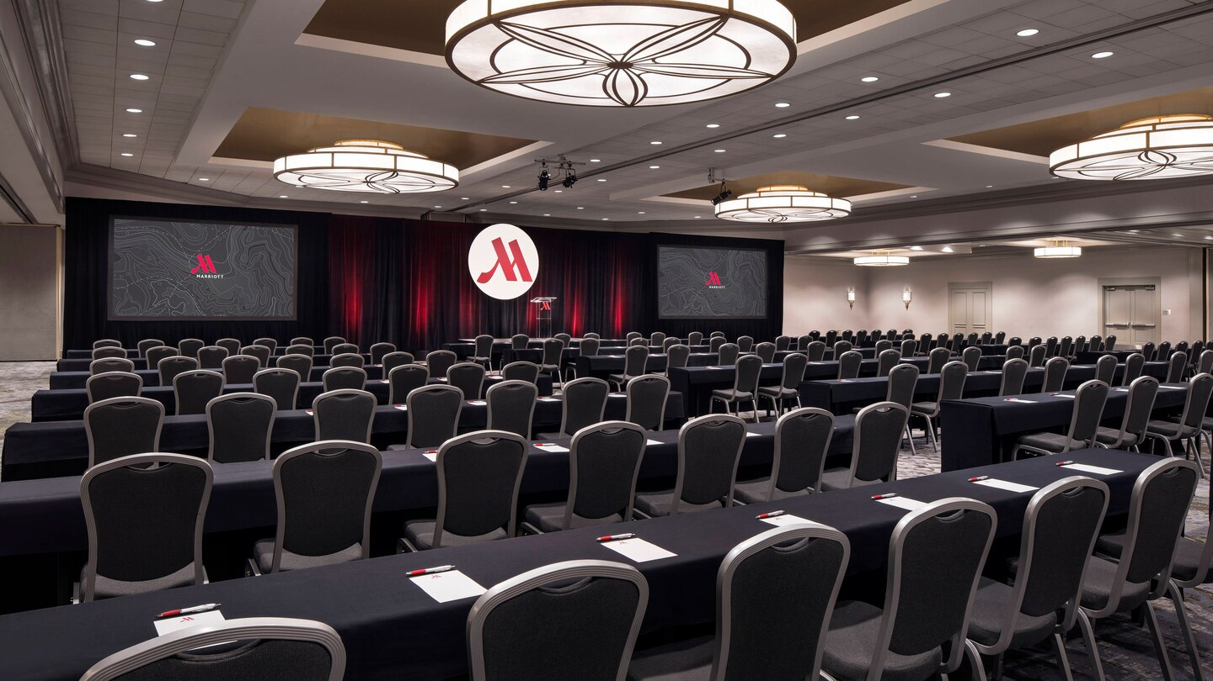
AEG 2023 Annual Meeting
Marriott Portland Downtown Waterfront
AEG 2021 Annual Meeting
Westin Meetings
Hotel

Slide 3
AEG 2023 Annual Meeting
FIELD COURSES
Field Course #1: Giant Landslides in the Columbia River Gorge
Field Course #2: Living with Giant Landslides in Portland, Oregon
Portland, Oregon - September 19-24, 2023

Slide 4
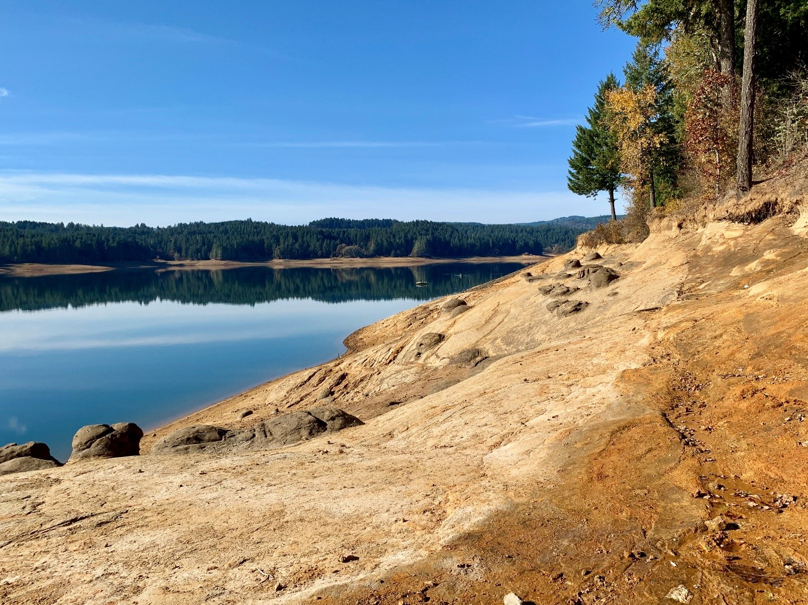
AEG 2023 Annual Meeting
FIELD COURSES
Field Course #3: Scoggins Dam Engineering Geology in the Cascadia Subduction Zone / Networking Opportunity
Field Course #4: Mt St Helens - Highlights of the 1980 Eruption and Engineering Geology after the Event
Portland, Oregon - September 19-24, 2023

Slide 5
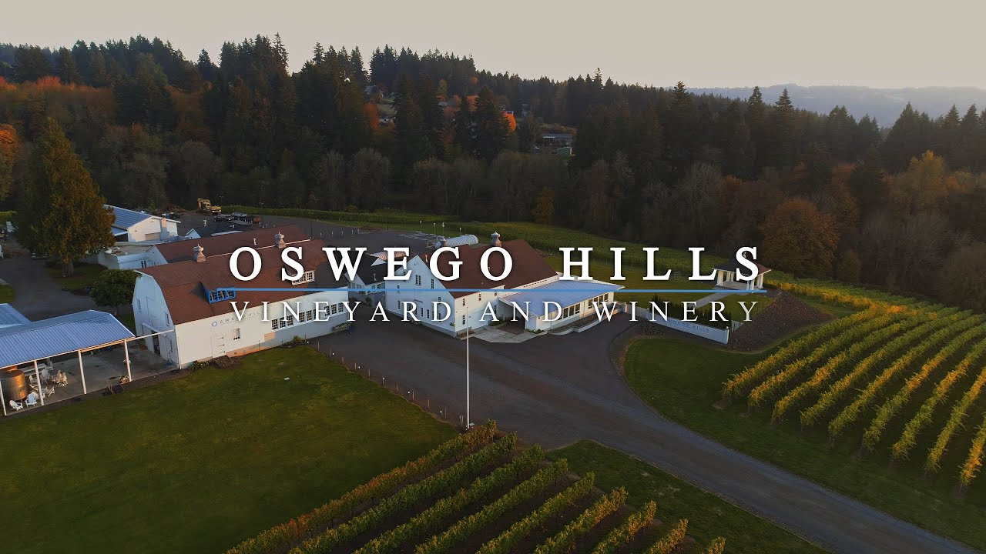
AEG 2023 Annual Meeting
SPECIAL EVENT
“Taste the Terroir”
Wednesday, September 20, 2023
6:00-10:00pm
Escape the city for an evening and join us for a wonderful outing to the picturesque vineyard at the Oswego Hills Winery. Learn about the local terroir and taste the wines of the Willamette Valley, named wine region of the year for the world in 2017 by Wine Enthusiast. Our very own Dr. Scott Burns will lead the wine tasting as he explains the importance of terroir, that is the relationship between geology, soil, climate, and wine. Scott is the past IAEG President, past AEG President, and has established himself as the local expert on terroir in the Willamette Valley. Wine tasting will be accompanied by appetizers and followed by dinner. Local craft beer will also be available. Transportation to and from the event will be provided. Please join us for what promises to be a fun and memorable evening as we showcase our region’s geology and wine in the beautiful setting of the Oswego Hills Winery!
Portland, Oregon - September 19-24, 2023

Slide 6

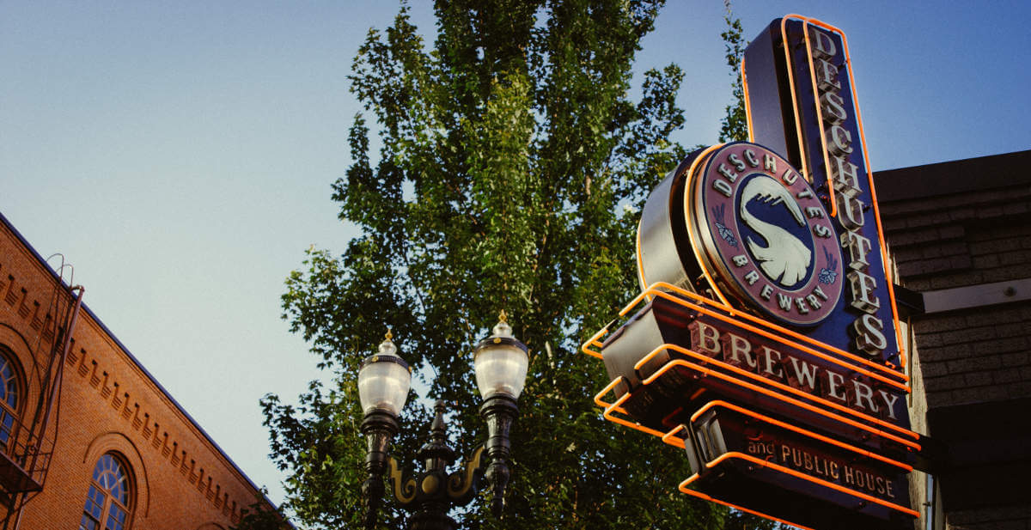
AEG 2023 Annual Meeting
Portland Fun Facts
Portland is home to the world’s largest independently owned bookstore
Powell’s Books
The Portland metro area is home to 117 breweries
Portland, Oregon - September 19-24, 2023

Slide 7
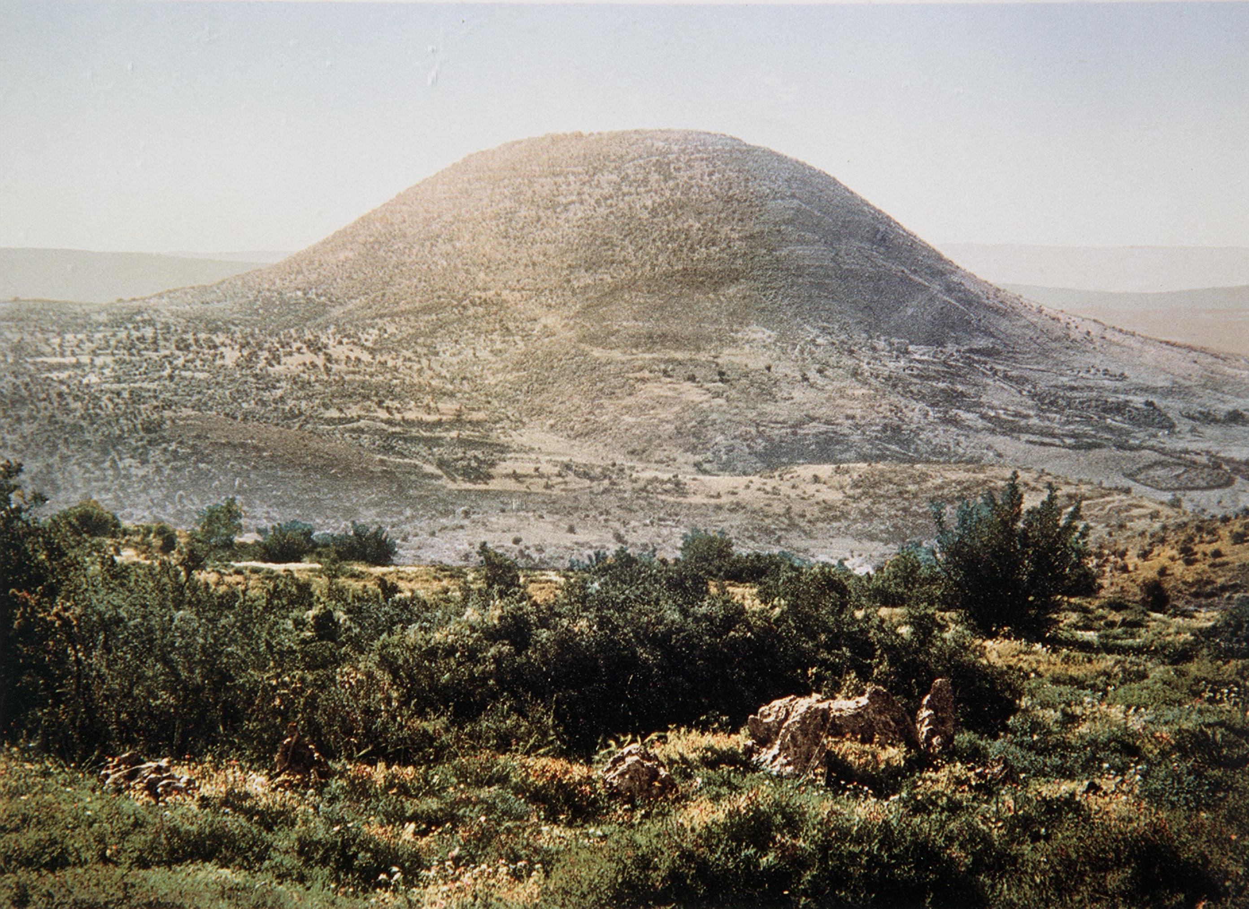
AEG 2023 Annual Meeting
Portland Geology Fact
Portland is one of two US cities to have a dormant volcano within its limits
Mt Tabor Park, East Portland
Portland, Oregon - September 19-24, 2023

Slide 8
AEG 2023 Annual Meeting
Marriott Portland Downtown Waterfront
AEG 2021 Annual Meeting
Westin Meetings
Mt Hood (11,200’)
An active Cascade Volcano resides < 50 miles from downtown Portland
Going to be an Unforgettable Experience!

